Slide 1
SQL Queries

Slide 2
Introduction
Briefly introduce SQL (Structured Query Language) and its significance in Database Management Systems (DBMS).
It provides a set of commands and queries that allow users to perform various operations, such as retrieving, inserting, updating, and deleting data in a database.
Mention the four main categories of SQL commands: DDL, DML, DCL, and TCL.

Slide 3
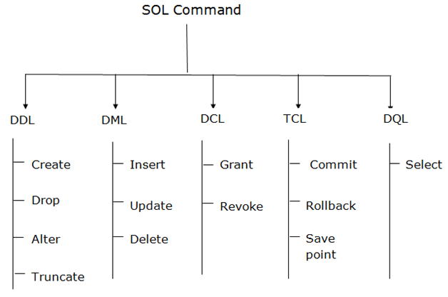
SQL Commands

Slide 4
Data Definition Language (DDL)
DDL commands are used for defining and managing database objects.
Data Definition Language (DDL) is a subset of SQL that deals with the creation, modification, and deletion of database objects.
Examples: CREATE DATABASE, CREATE TABLE, ALTER TABLE, DROP TABLE.
DDL commands are used to define the structure and organization of a database, including tables, indexes, views, and constraints.

Slide 5
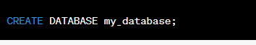
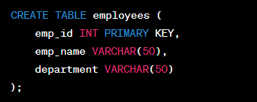
Examples:
Example of CREATE DATABASE
Output: Query OK, 1 row affected (0
Example of CREATE TABLE

Slide 6
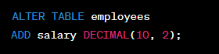
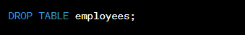
Example of ALTER TABLE
Output: Query OK, 0 rows affected (0.05 sec)
ALTER TABLE Customers DROP COLUMN <ColumnName>;
ALTER TABLE table_name RENAME COLUMN old_name to new_name;
ALTER TABLE table_name MODIFY COLUMN column_name datatype;
Example of DROP TABLE
Output: Query OK, 0 rows affected (0.05 sec)

Slide 7
Data Manipulation Language (DML)
DML (Data Manipulation Language) is a subset of SQL (Structured Query Language) that focuses on performing operations.
DML allows users to retrieve, insert, update, and delete data from database tables.
DML commands are used to manipulate data within the database.
Examples: INSERT INTO, UPDATE, DELETE.

Slide 8
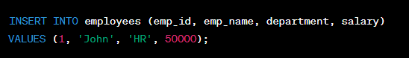
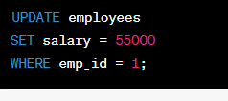
Examples:
Example of INSERT INTO
Output: Query OK, 1 row affected (0.00 sec)
INSERT INTO table_name VALUES (value1, value2,...);
Example of UPDATE
Output: Query OK, 1 row affected (0.00 sec)

Slide 9
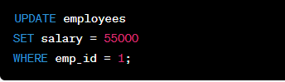
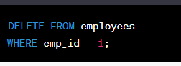
Example of UPDATE
Output: Query OK, 1 row affected (0.00 sec)
Example of DELETE
Output: Query OK, 1 row affected (0.00 sec)

Slide 10
Data Control Language (DCL)
DCL (Data Control Language) is a subset of SQL (Structured Query Language) that deals with controlling access to the database and managing user privileges.
DCL commands are used to manage access and permissions to the database.
Examples: GRANT, REVOKE.
DCL commands allow database administrators to define and grant permissions, ensuring data security and privacy.

Slide 11
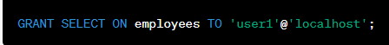
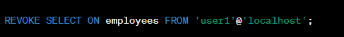
Examples:
Example of GRANT
Output: Query OK, 0 rows affected (0.05 sec)
Example of REVOKE
Output: Query OK, 0 rows affected (0.05 sec)

Slide 12
Practice questions
Question 1: Add a New Column Add a column named "Phone" to the "Customers" table with a data type of VARCHAR(15).
Question 2: Modify Column Data Type Change the data type of the "Birthdate" column in the "Employees" table from DATE to DATETIME.
Question 3: Rename a Column Rename the column "ProductDesc" to "Description" in the "Products" table.
Question 4: Add a Primary Key Add a primary key constraint to the "Orders" table using the "OrderID" column.
Question 5: Add a Foreign Key Add a foreign key constraint to the "Orders" table referencing the "CustomerID" column in the "Customers" table.
Question 6: Remove a Column Remove the "Notes" column from the "Suppliers" table.
Question 7: Modify Column Size Increase the maximum length of the "FirstName" column in the "Employees" table from 50 to 100 characters.
Question 8: Add a Check Constraint Add a check constraint to the "Students" table to ensure that the "Age" column values are greater than or equal to 18.
Question 9: Rename a Table Rename the table "OldCustomers" to "NewCustomers".
Question 10: Modify Nullable Constraint Change the "Address" column in the "Customers" table to allow NULL values.

